Slide 1
成對學習應用於偽造影像/視訊偵測 Detecting Generated Image/Video based on Pairwise Learning
Presenter: Yi-Xiu Zhuang
Department of Management Information Systems,
National Pingtung University of Science and Technology, Taiwan

Slide 2
Outline
Introduction
Related Work
The proposed Method
Experiment result
Conclusion
1

Slide 3
Outline
Introduction
Related Work
The proposed Method
Experiment result
Conclusion
1

Slide 4
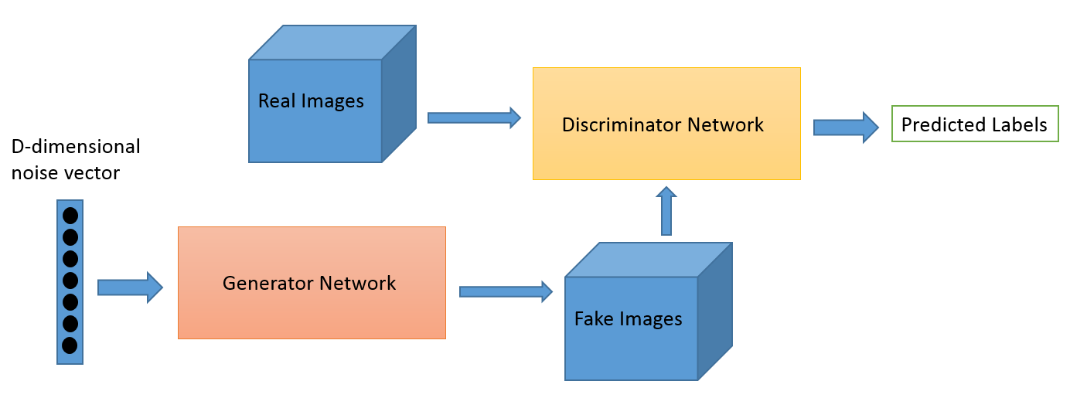
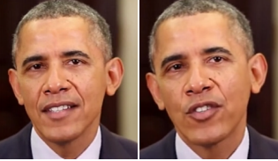
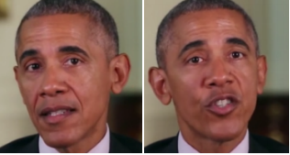

Introduction
Image/Video generation have been a potential threat nowadays
Most of these were synthesized by GAN
Traditional forgery detection approach
Deep learning approach
Fails to detect the fake image/video
The studies focus on fake image detection based on deep learning approach are inefficient.
Supervised learning model is relatively weak to identify the new class exclude in the training set.
Collect all possible GANs is very time consuming
The fake features of the generated images from different GANs may be different, the traditional one-stream CNN may not well capture all possible fake features of the images.
2

Slide 5
Introduction (cont.)
To solve the problems mentioned previously
Propose a pairwise learning approach
Learn the common fake feature over the training images generated by different GANs.
Propose two networks to adequately capture the local and global image features for the fake or real images.
Siamese network
Novel coupled neural network
Use two loss functions to model the relation between the fake and real images.
Contrastive loss
Triplet loss
Features can be visualized to localize the unrealistic details.
3

Slide 6
Introduction (cont.)
Used two state-of-the-art model to detect fake video
EfficientNet
ResNext
Analysis the performance and try to improve
4

Slide 7
Outline
Introduction
Related Work
The proposed Method
Experiment result
Conclusion
1

Slide 8
Related Work
Traditional image forgery
Extrinsic feature
Intrinsic feature
Deep learning approach
CNN
VGG16&VGG19
ResNet
DenseNet
5

Slide 9
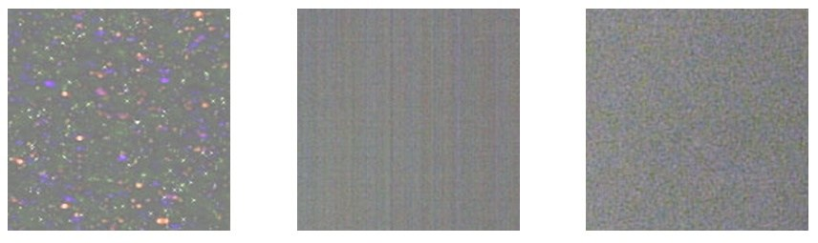
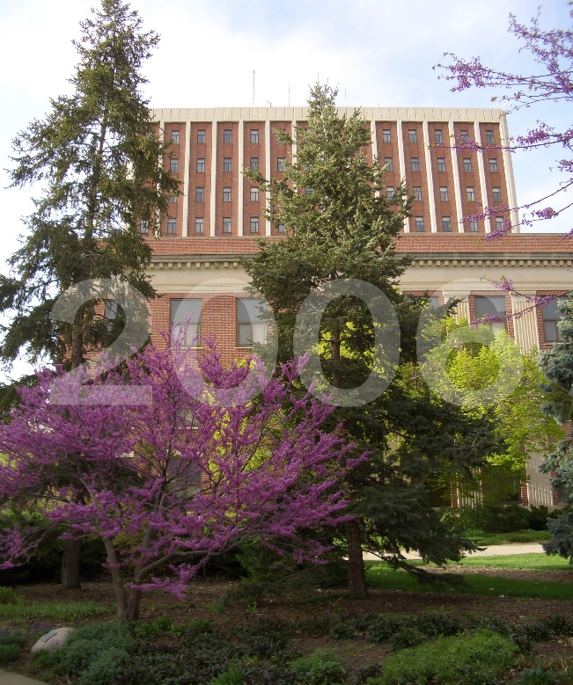
Related Work – Traditional Image forgery
Extrinsic feature
Watermark
Intrinsic feature
Pattern noise
6

Slide 10
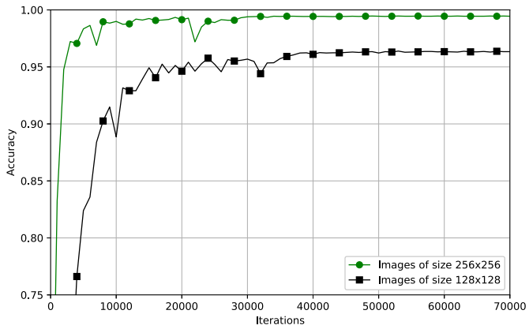
Related Work – Deep learning Approach
Fake Faces Identification via Convolutional Neural Network
Propose a CNN to classify the fake images
7
Mo, Huaxiao, Bolin Chen, and Weiqi Luo. "Fake faces identification via convolutional neural network." Proceedings of the 6th ACM Workshop on Information Hiding and Multimedia Security. 2018.

Slide 11
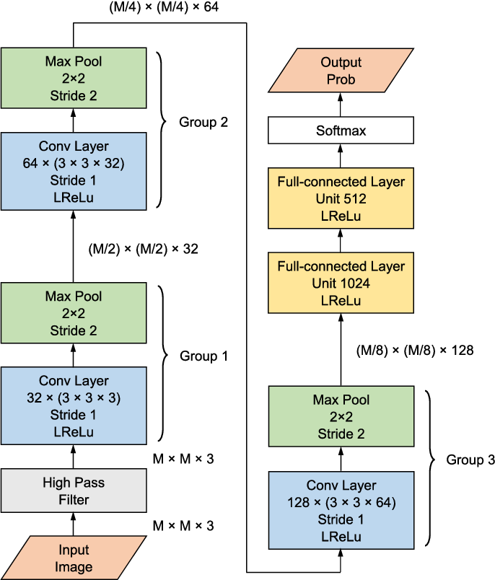
Related Work – Deep learning Approach
Formed by convolutional & pool & full-connected layer
Performance already better than traditional approach
8

Slide 12
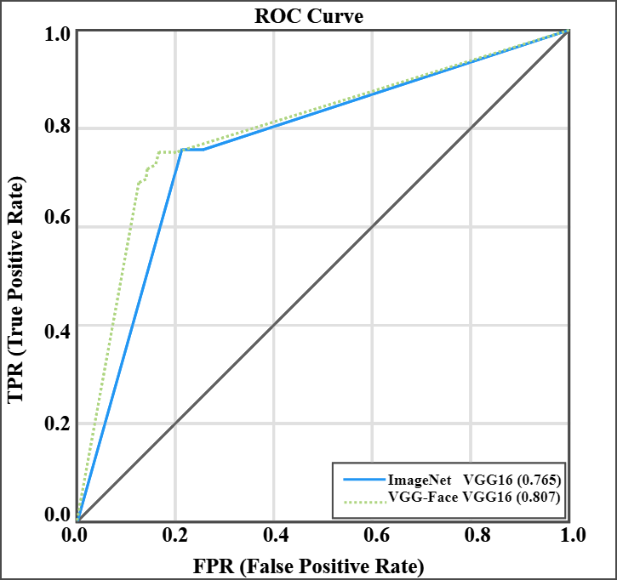
Related Work – Deep learning Approach
Forensics Face Detection From GANs Using Convolutional Neural Network
Propose VGG16 to classify the ImageNet & fake images
9
Do, Nhu-Tai, In-Seop Na, and Soo-Hyung Kim. "Forensics face detection from gans using convolutional neural network." (2018).

Slide 13
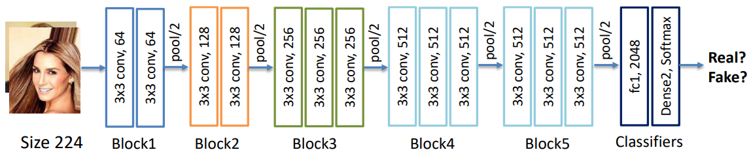
Related Work – Deep learning Approach
Use 3x3 filter to build conv layer
10

Slide 14
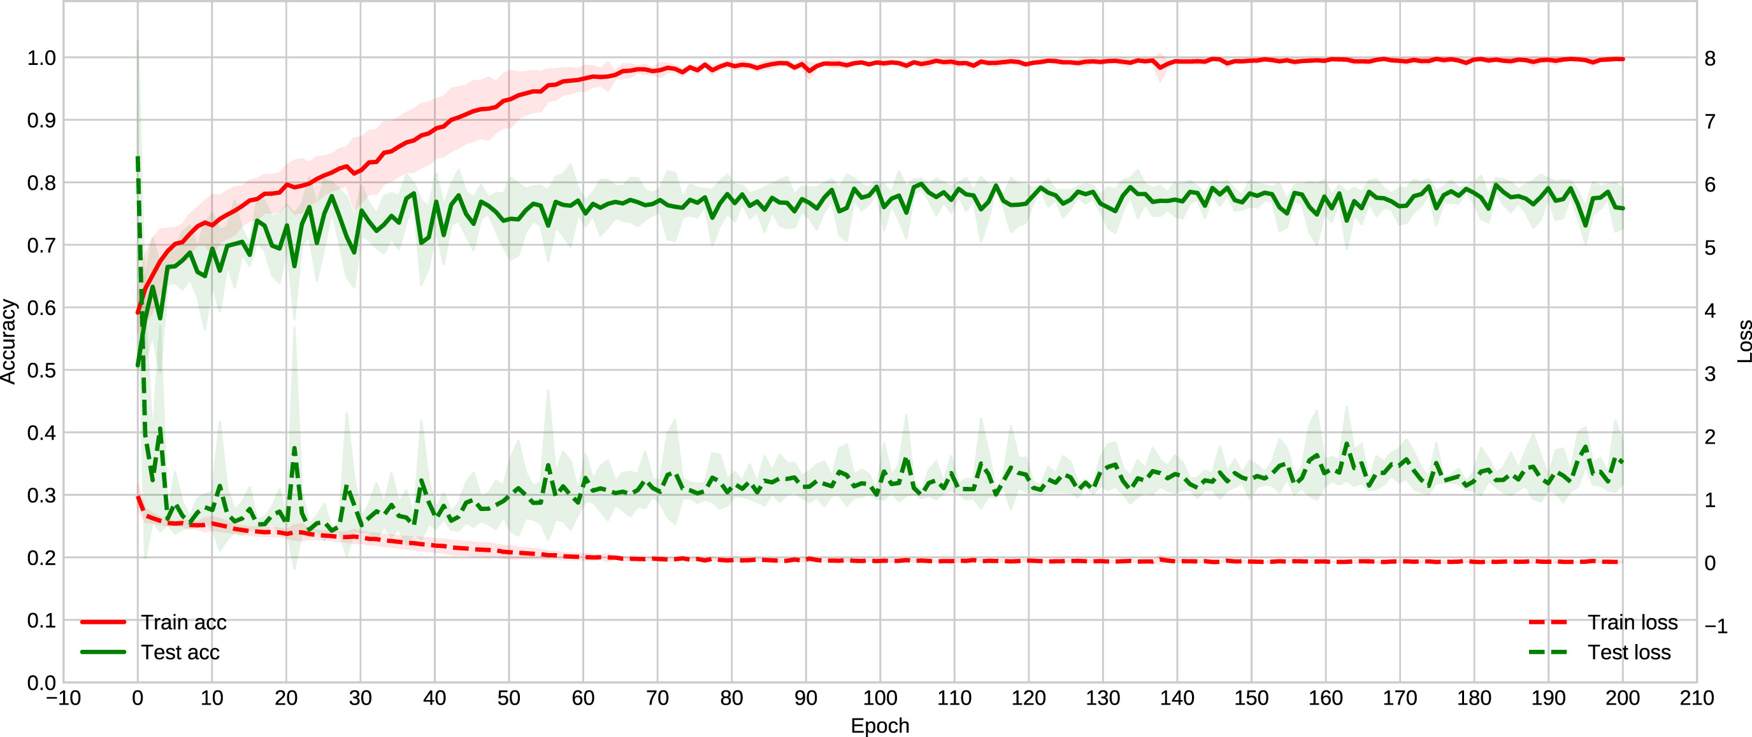
Related Work – Deep learning Approach
Exposing computer generated images by using deep convolutional neural networks
Propose ResNet50 to classify the fake image
11
De Rezende, Edmar RS, et al. "Exposing computer generated images by using deep convolutional neural networks." Signal Processing: Image Communication 66 (2018): 113-126.

Slide 15
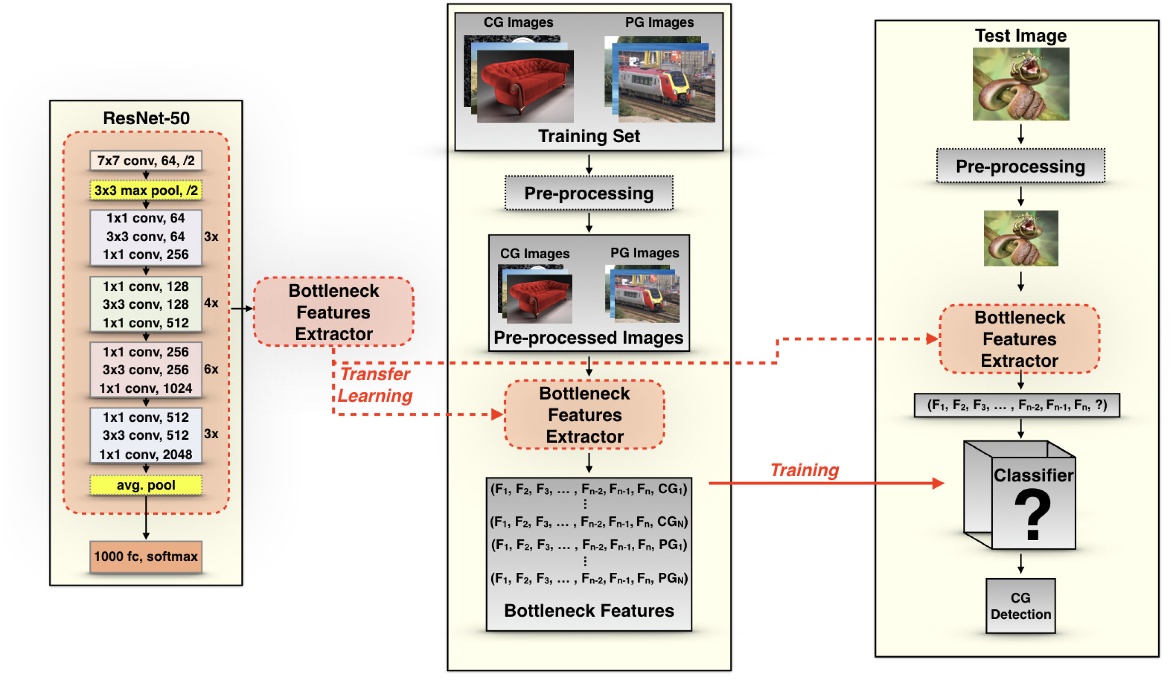
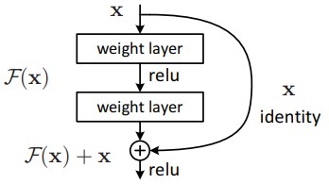
Related Work – Deep learning Approach
Transfer ResNet-50 layer’s parameter to extract bottleneck features to train different classifier
12

Slide 16
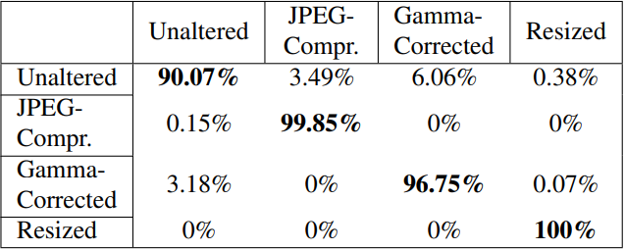
Related Work – Deep learning Approach
Application of DenseNet in Camera Model Identification and Post-processing Detection
Propose a model based on DenseNet-201 to classify manipulated images
Muntakim Rafi, Abdul, et al. "Application of DenseNet in Camera Model Identification and Post-processing Detection. " Proceedings of the IEEE Conference on Computer Vision and Pattern Recognition Workshops. 2019.
13

Slide 17
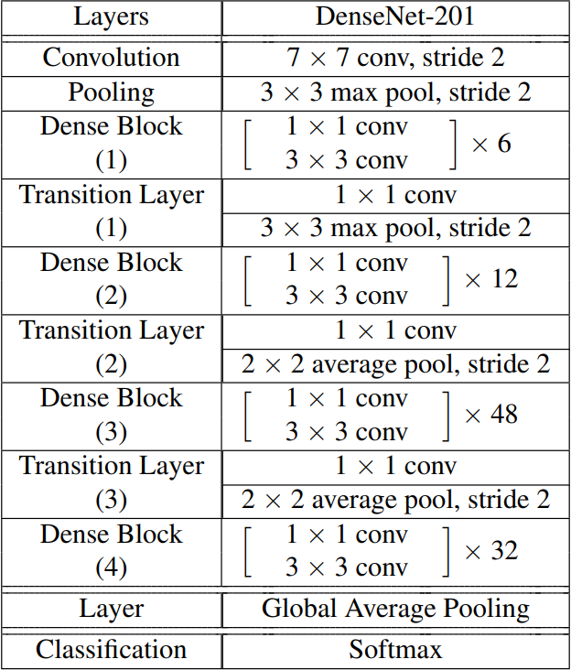
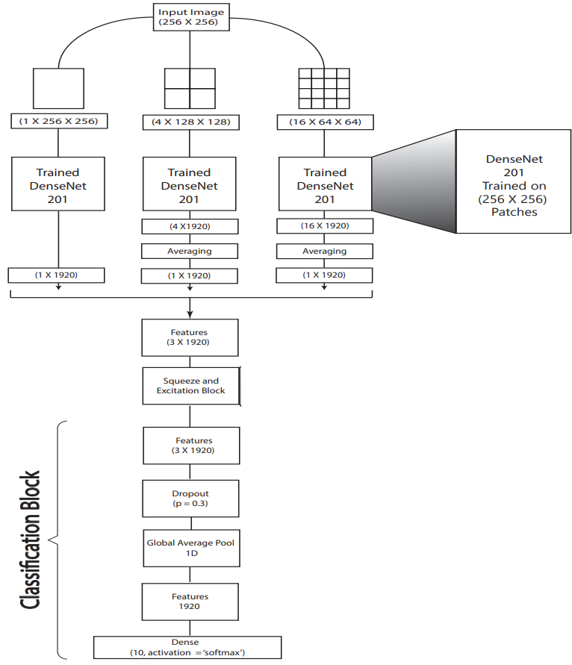
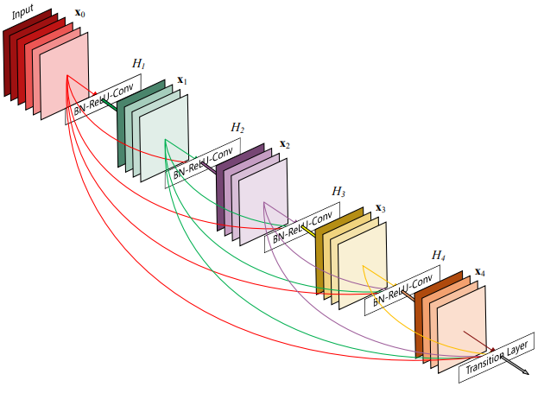
Related Work – Deep learning Approach
14

Slide 18
Motivation
Traditional image forgery
Cons.
Cannot find the fake statistical information from GAN’s images
Supervised Learning CNN
Cons.
It is hard to generalize
May fail to detect new class (new GAN’s image)
15

Slide 19
Outline
Introduction
Related Work
The proposed Method
Experiment result
Conclusion
1

Slide 20
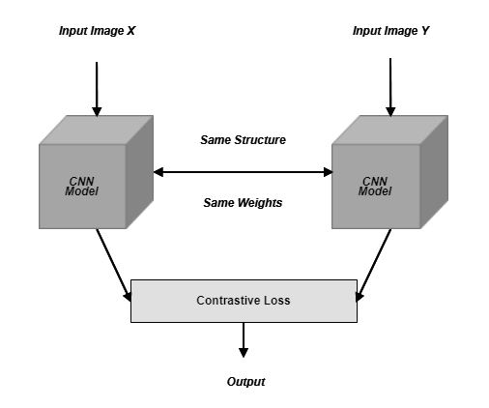
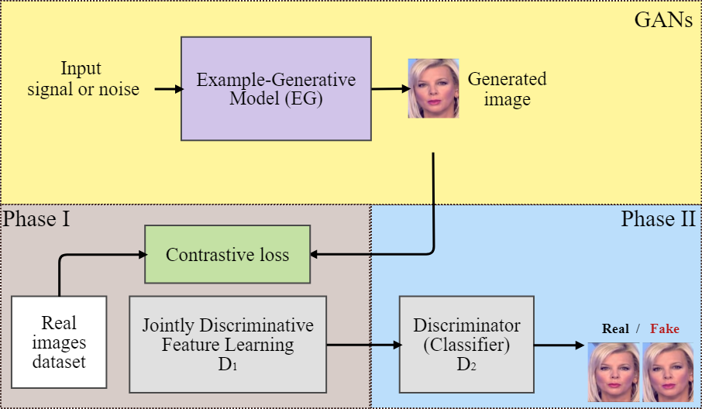
The proposed Model
Layers | D1 | D2
1 | Conv.layer, Kernel=7*7, Stride=4,channel=96 | Conv.layer, Kernel=3*3 Channel=2
2 | Residual block*2, Channel=96 | Global Avg pooling
3 | Residual block*2, Channel=128 | Fully connected layer, neurons=2 Softmax layer / Fully convolutional layer
4 | Residual block*2, Channel=256
5 | Fully connected layer, neurons=128 Softmax layer
16

Slide 21
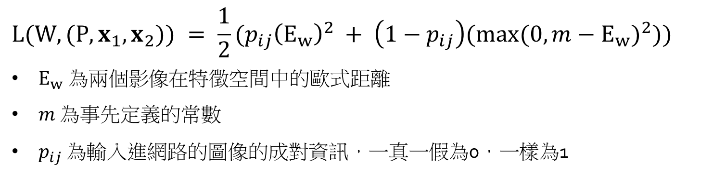
Contrastive loss
$$L(W,(P, x_{1},x_{2})) = \frac{1}{2}(p_{ij}{\left(E_{w}\right)}^{2} + \left(1−p_{ij}\right)(\max{{(0,m−E_{w})}^{2}}))$$
$E_{w} 為兩個影像$在特徵空間中的歐式距離
$m$ 為事先定義的常數
$p_{ij}$ 為輸入進網路的圖像的成對資訊，一真一假為0，一樣為1
17

Slide 22
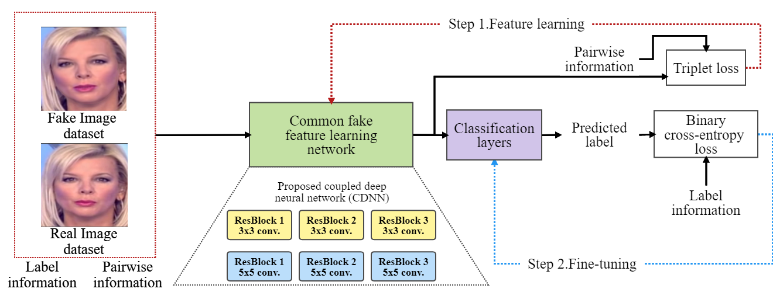
The proposed Model
18

Slide 23
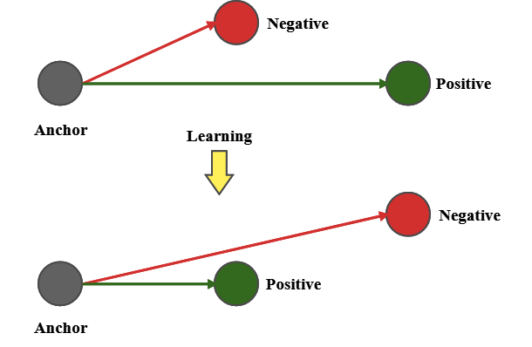
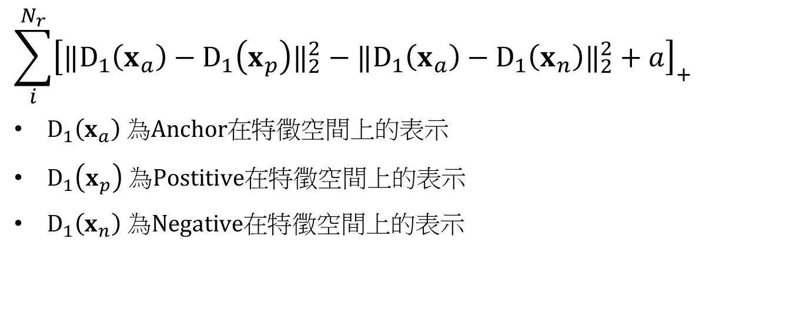
Triplet loss
$$\sum_{i}^{N_{r}}{{\left[‖D_{1}\left(x_{a}\right)−D_{1}\left(x_{p}\right)‖_{2}^{2}−‖D_{1}\left(x_{a}\right)−D_{1}\left(x_{n}\right)‖_{2}^{2}+a\right]}_{+}}$$
$D_{1}\left(x_{a}\right) 為Anchor在$特徵空間上的表示
$D_{1}\left(x_{p}\right) 為Postitive在$特徵空間上的表示
$D_{1}\left(x_{n}\right) 為Negative在$特徵空間上的表示
19

Slide 24
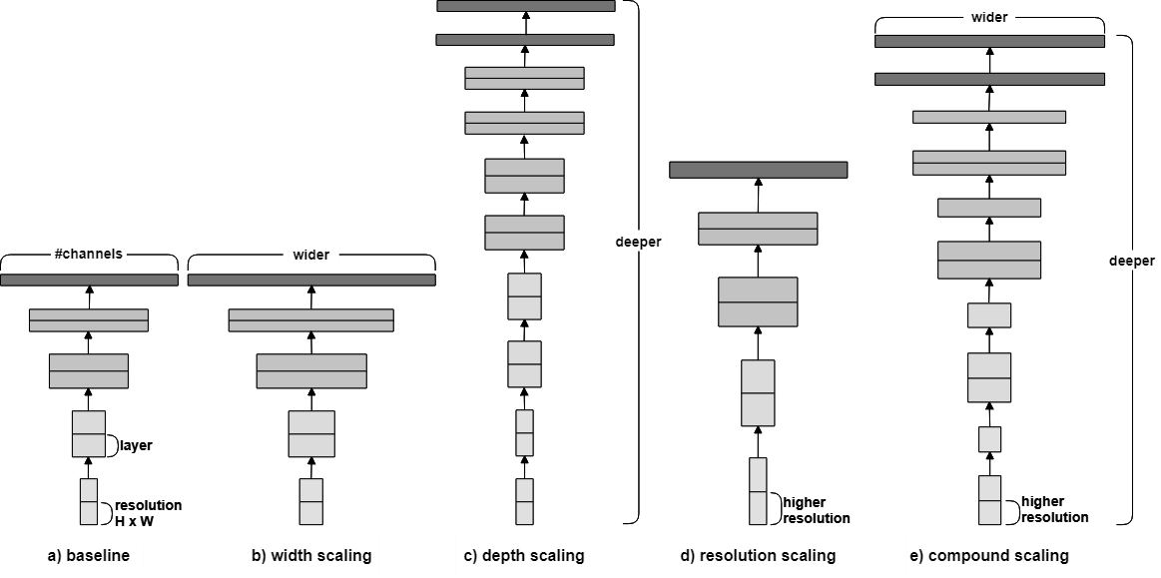
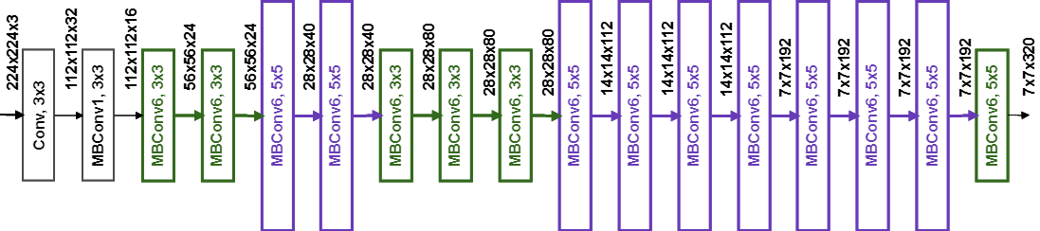
EfficientNet
Model | Top-1 Acc | Top-5 Acc | Params | FLOPS
EfficientNet-B0 | 76.3% | 93.2% | 5.3M | 0.39 B
EfficientNet-B1 | 78.8% | 94.4% | 7.8 M | 0.70 B
EfficientNet-B2 | 79.8% | 94.9% | 9.2 M | 1.0 B
EfficientNet-B3 | 81.1% | 95.5% | 12 M | 1.8 B
EfficientNet-B4 | 82.6% | 96.3% | 19 M | 4.2 B
EfficientNet-B5 | 83.3% | 96.7% | 30 M | 9.9 B
EfficientNet-B6 | 84.0% | 96.9% | 43 M | 19 B
EfficientNet-B7 | 84.4% | 97.1% | 66 M | 37 B
20

Slide 25
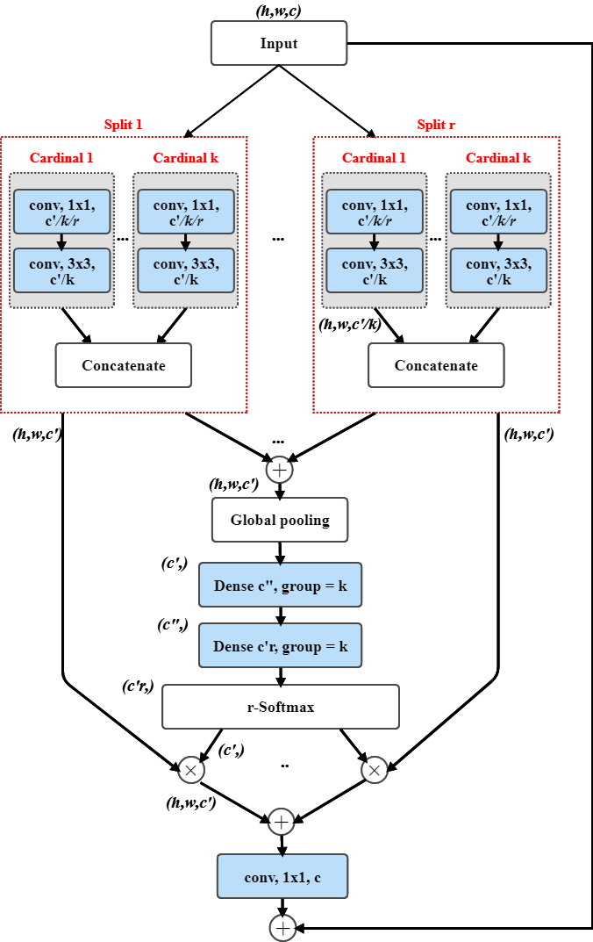
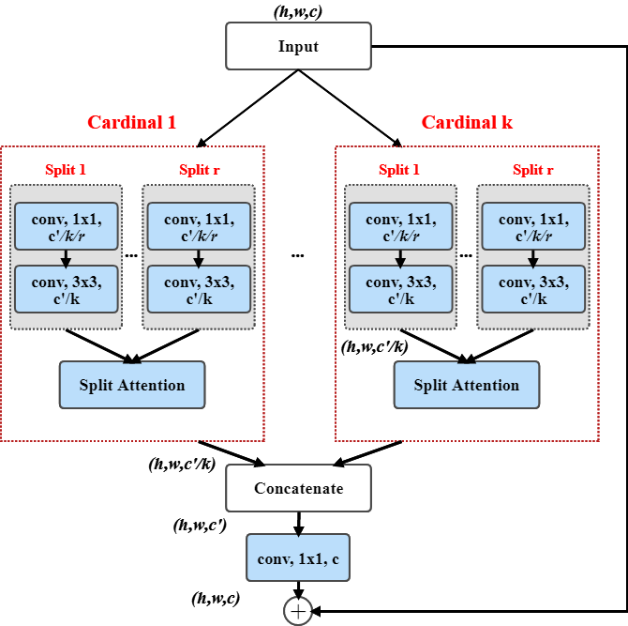
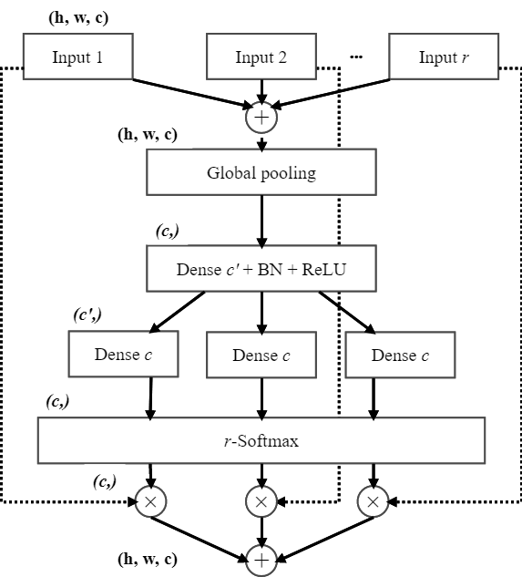
ResNeSt
21

Slide 26
Outline
Introduction
Related Work
The proposed Method
Experiment result
Conclusion
1

Slide 27
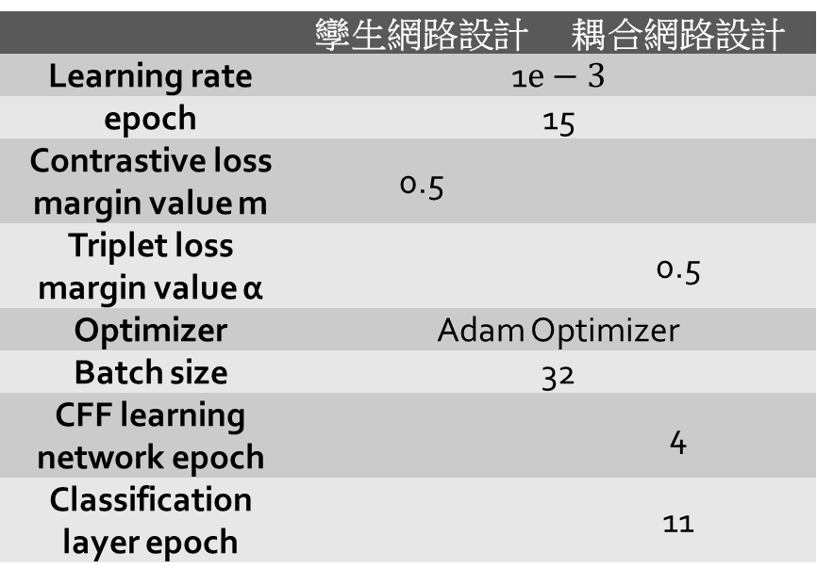
Experiment Setting
Dataset | GANs | DCGAN、WGAN、WGAN-GP、LSGAN、PGGAN
 | True Image Dataset | CelebA
 | True Image Numbers | 202,599
 | Fake Image Numbers | 200,000
 | Fake Image Size | 64*64
 | Training Image Numbers | 385,198
 | Test Image Numbers | 10,000
 | 孿生網路設計 | 耦合網路設計
Learning rate | 1$e−3$
epoch | 15
Contrastive loss margin value m | 0.5
Triplet loss margin value α |  | 0.5
Optimizer | Adam Optimizer
Batch size | 32
CFF learning network epoch |  | 4
Classification layer epoch |  | 11
22

Slide 28
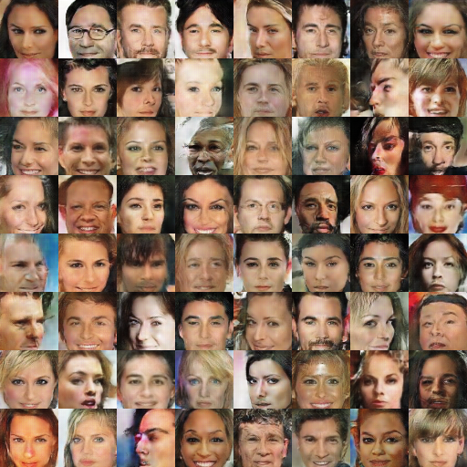
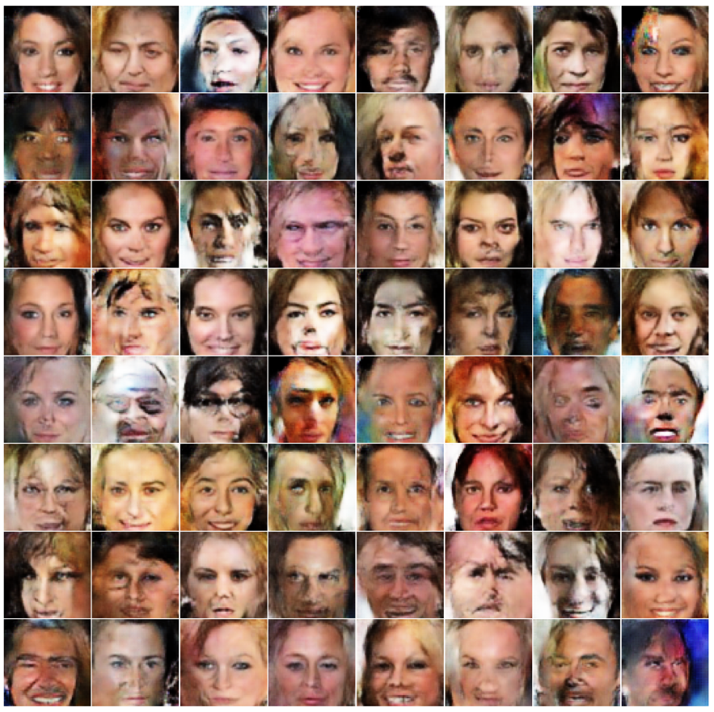
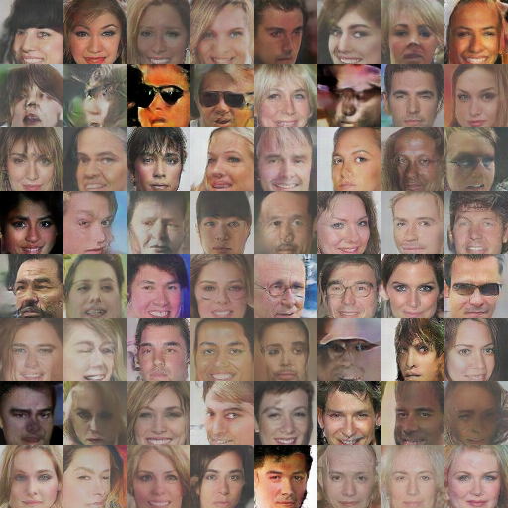
GANs
DCGAN WGAN WGAN-GP
23

Slide 29
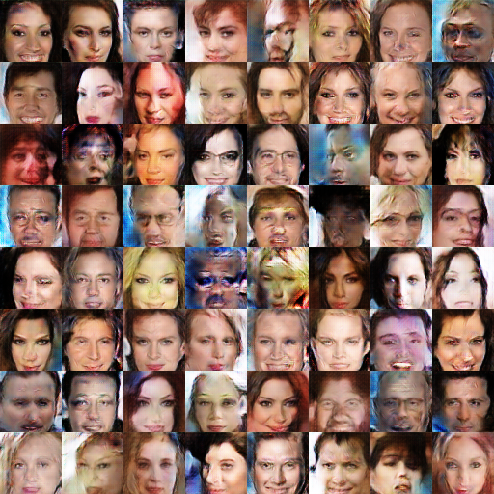
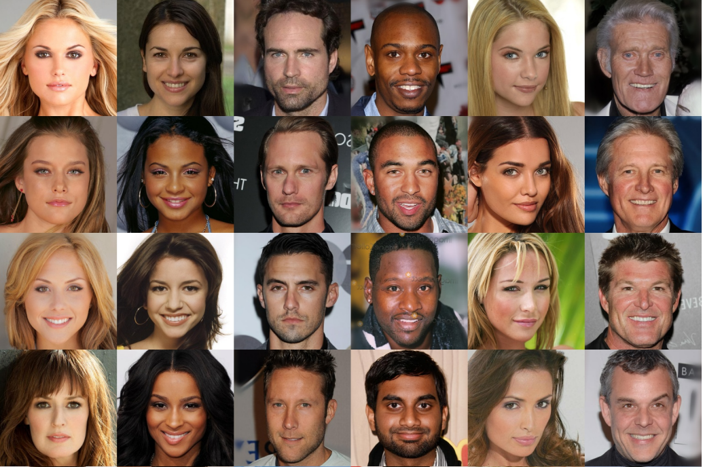
GANs
LSGAN PGGAN(Progressive growing GAN)
24

Slide 30
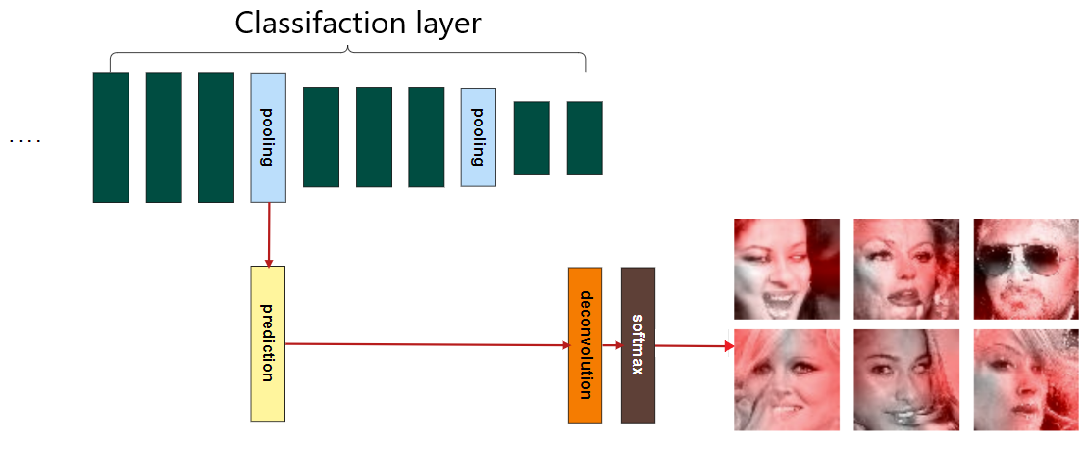
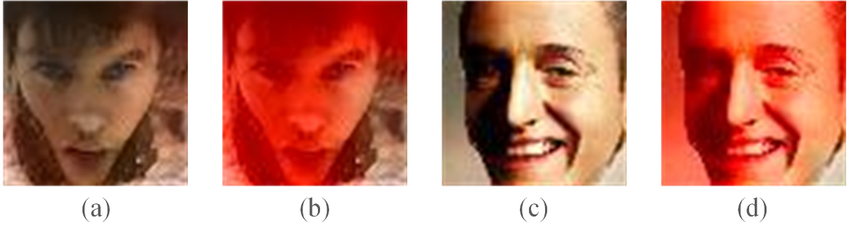
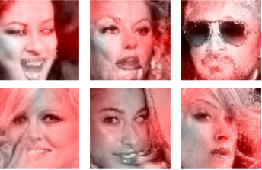
Experiment Result
25

Slide 31
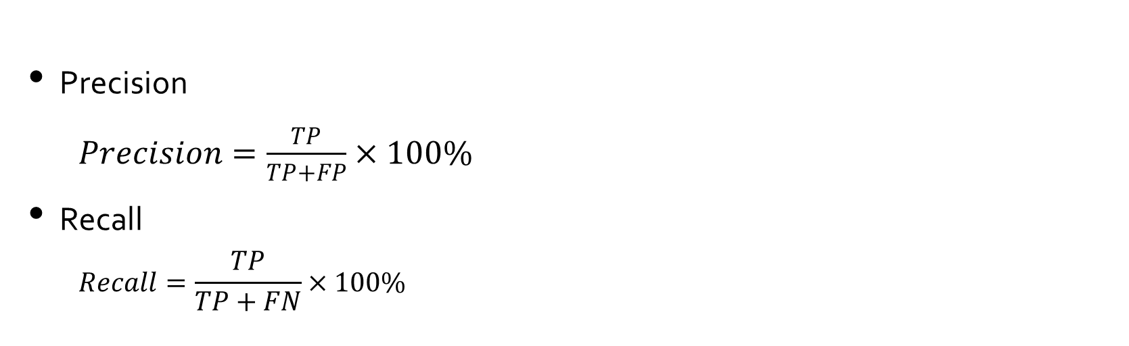
Experiment Result
Precision
$Precision=\frac{TP}{TP+FP}×100\%$
Recall
$$Recall=\frac{TP}{TP+FN}×100\%$$
26

Slide 32
Method/Test target | LSGAN |  | DCGAN |  | WGAN |  | WGAN-GP |  | PGGAN
 | precision | recall | precision | recall | precision | recall | precision | recall | precision | recall
Hany Farid, “Image forgery detection” | 0.205 | 0.580 | 0.253 | 0.774 | 0.235 | 0.673 | 0.242 | 0.604 | 0.222 | 0.862
Bolin Chen Huaxiao Mo and Weiqi Luo, “Fake faces identification via convolutional neural network” | 0.819 | 0.528 | 0.848 | 0.790 | 0.817 | 0.822 | 0.816 | 0.679 | 0.798 | 0.788
F. Marra, D. Gragnaniello, D. Cozzolino, and L. Verdoliva, “Detection of gan-generated fake images over social networks” | 0.833 | 0.725 | 0.812 | 0.833 | 0.840 | 0.809 | 0.826 | 0.733 | 0.824 | 0.838
The proposed-I | 0.947 | 0.922 | 0.871 | 0.844 | 0.838 | 0.847 | 0.818 | 0.835 | 0.926 | 0.918
Baseline-I | 0.921 | 0.915 | 0.887 | 0.831 | 0.860 | 0.855 | 0.822 | 0.837 | 0.919 | 0.898
Baseline-II | 0.939 | 0.929 | 0.878 | 0.851 | 0.840 | 0.863 | 0.845 | 0.844 | 0.922 | 0.928
Baseline-III | 0.845 | 0.785 | 0.796 | 0.816 | 0.833 | 0.799 | 0.819 | 0.805 | 0.835 | 0.854
The proposed-II | 0.981 | 0.956 | 0.986 | 0.986 | 0.895 | 0.881 | 0.876 | 0.881 | 0.951 | 0.936
Baseline-I: From two-step learning to joint learning
Baseline-II:Remove 5x5 section，keep the 3x3
Baseline-III:Remove Triplet loss，keep the coupled network architecture
27

Slide 33
Experiment Setting
Dataset | Type | Neural Textures, DeepFake, Face2Face, FaceSwap,
 | Training Video Dataset | DeepFake
 | True Video Numbers | 4363
 | Fake Video Numbers | 7068
 | Video size | 640,480~1920,1080
 | Validation Video Dataset | DFDC
 | True Video Numbers | 16,154
 | Fake Video Numbers | 96,992
 | Video size | 1920,1080
 | EfficientNetB5 | ResNeSt101
Learning rate | Adam:0.001 / SGD:0.01
Learning rate decay | PolyLR
Epoch | 30
Label smoothing | 0.1
Optimizer | Adam Optimizer / SGD Optimizer
Batch size | 16
Batch Normalize | SyncBN
ResNest101 的 k |  | 64
ResNest101 的 r |  | 2
28

Slide 34
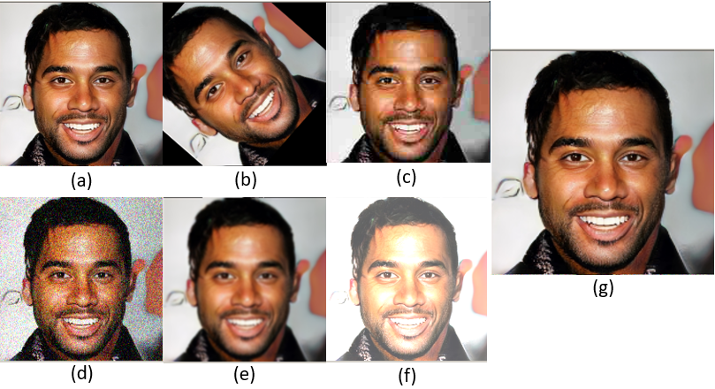
Data Augmentation
28

Slide 35
Experiment Result
Adjustment Model | Original |  | Data Augmentation |  | Model Adjustment |  | Mixed
 | precision | recall | precision | recall | precision | recall | precision | recall
EfficientNetB5 | 0.6623 | 0.8572 | 0.5716 | 0.6908 | 0.7775 | 0.9027 | 0.5737 | 0.6922
ResNeSt101 | 0.5826 | 0.7157 | 0.5525 | 0.5173 | 0.6829 | 0.604 | 0.5165 | 0.5421
Data Augmentation:
Shift&Scale&Rotate
JpegCompression
GaussNoise
GaussianBlur
IsotropicResize
Color jittering
Model Adjustment:
Optimizer
Learning rate
Learning rate decay
Batch normalization
Label Smoothing
EfficientNetB5 is better than ResNest in all aspects
Network with data augmentation didn’t performed well, may need more epoch to train
Network with model adjustment performed beyond expectations, will keep fine-tune the model based on these Adjustment
29

Slide 36
Outline
Introduction
Related Work
The proposed Method
Experiment result
Conclusion
1

Slide 37
Conclusion
Experimental results demonstrate that the proposed method outperforms other baseline approaches in terms of precision and recall rate.
The common fake feature learning approach allows the learned feature representation can be generalized, leading to better performance and more practical.
The proposed coupled deep neural network can well capture the local and global feature representation so that the detection performance can be further improved.
By analysis the result of the fake video detect, It will be a huge help for me to design the new fake video detector or fine-tune the EfficientNet.
30

Slide 38
Thank you for your attention
31

